Slide 1
Model-based Integrated Planning and Control of Autonomous Vehicles using Artificial Potential Fields with uncertain environment
Emilio Benenati
Josyula Viswanath Das
13th Decemeber 2021

Slide 2
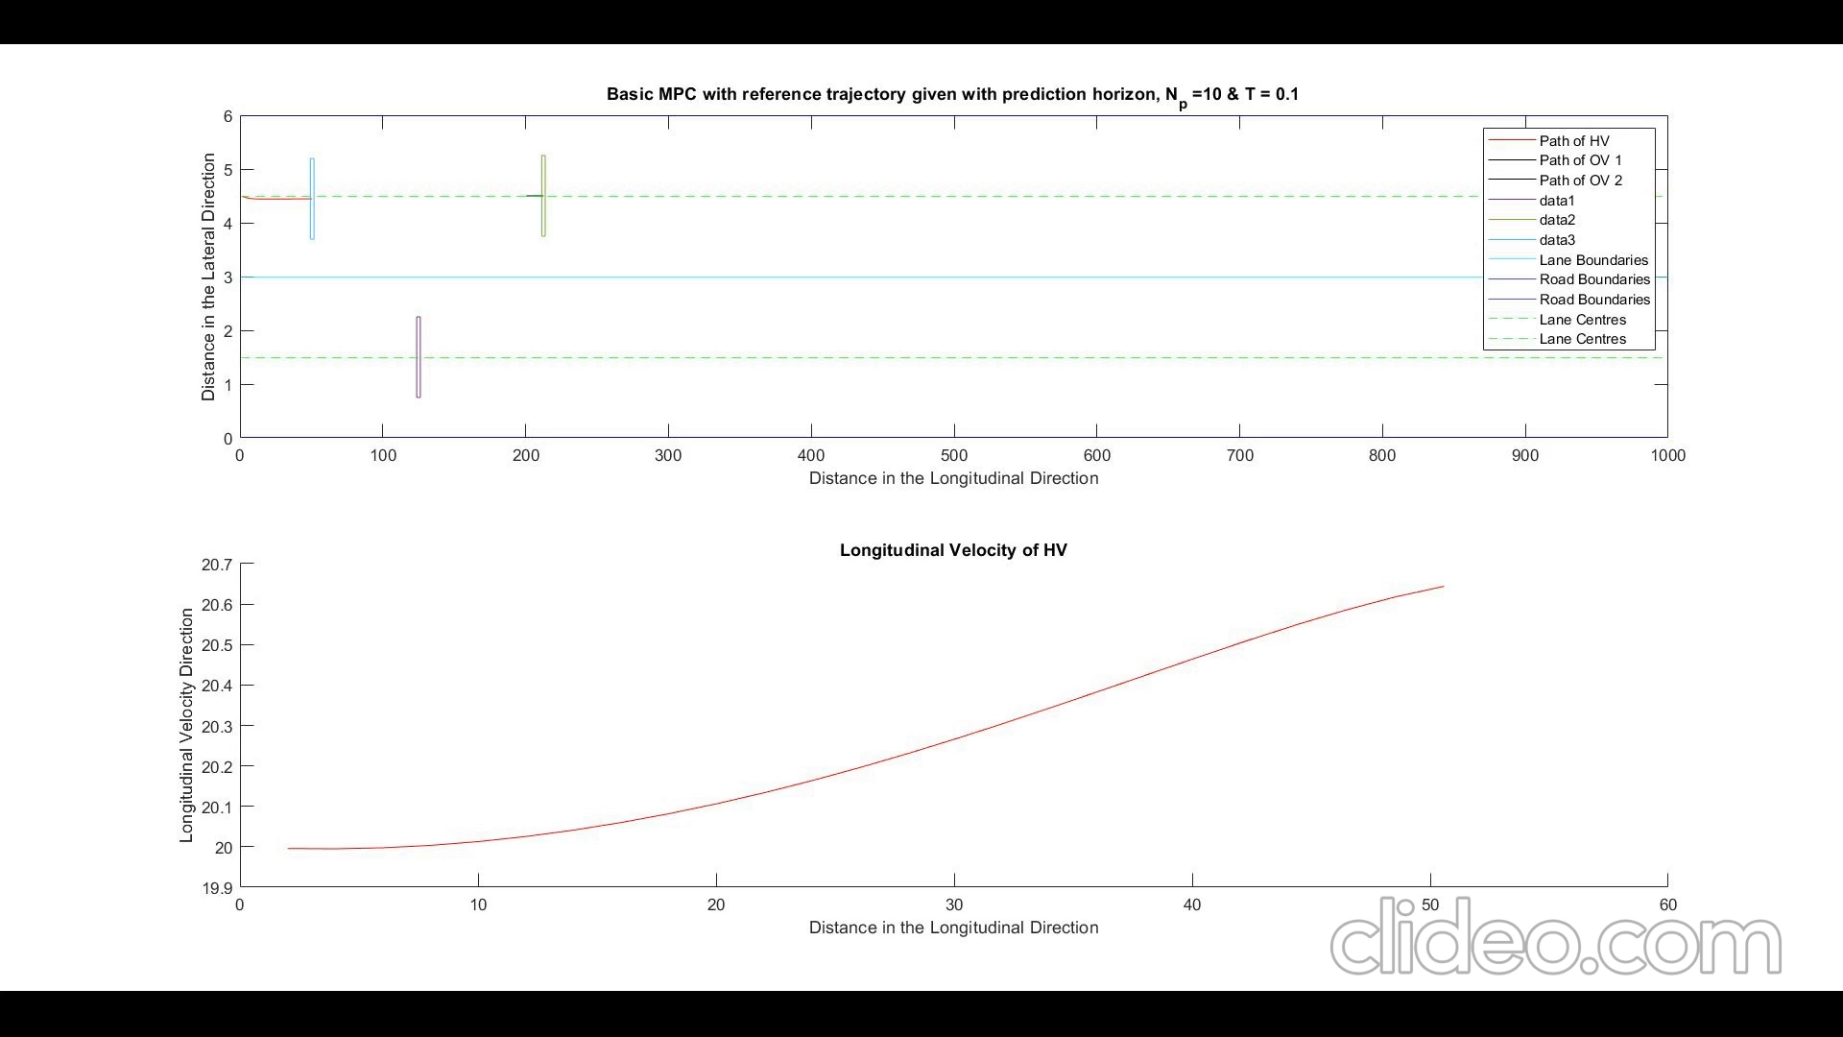
Path Travelled and Longitudinal Velocity of the Host Vehicle.

Slide 3
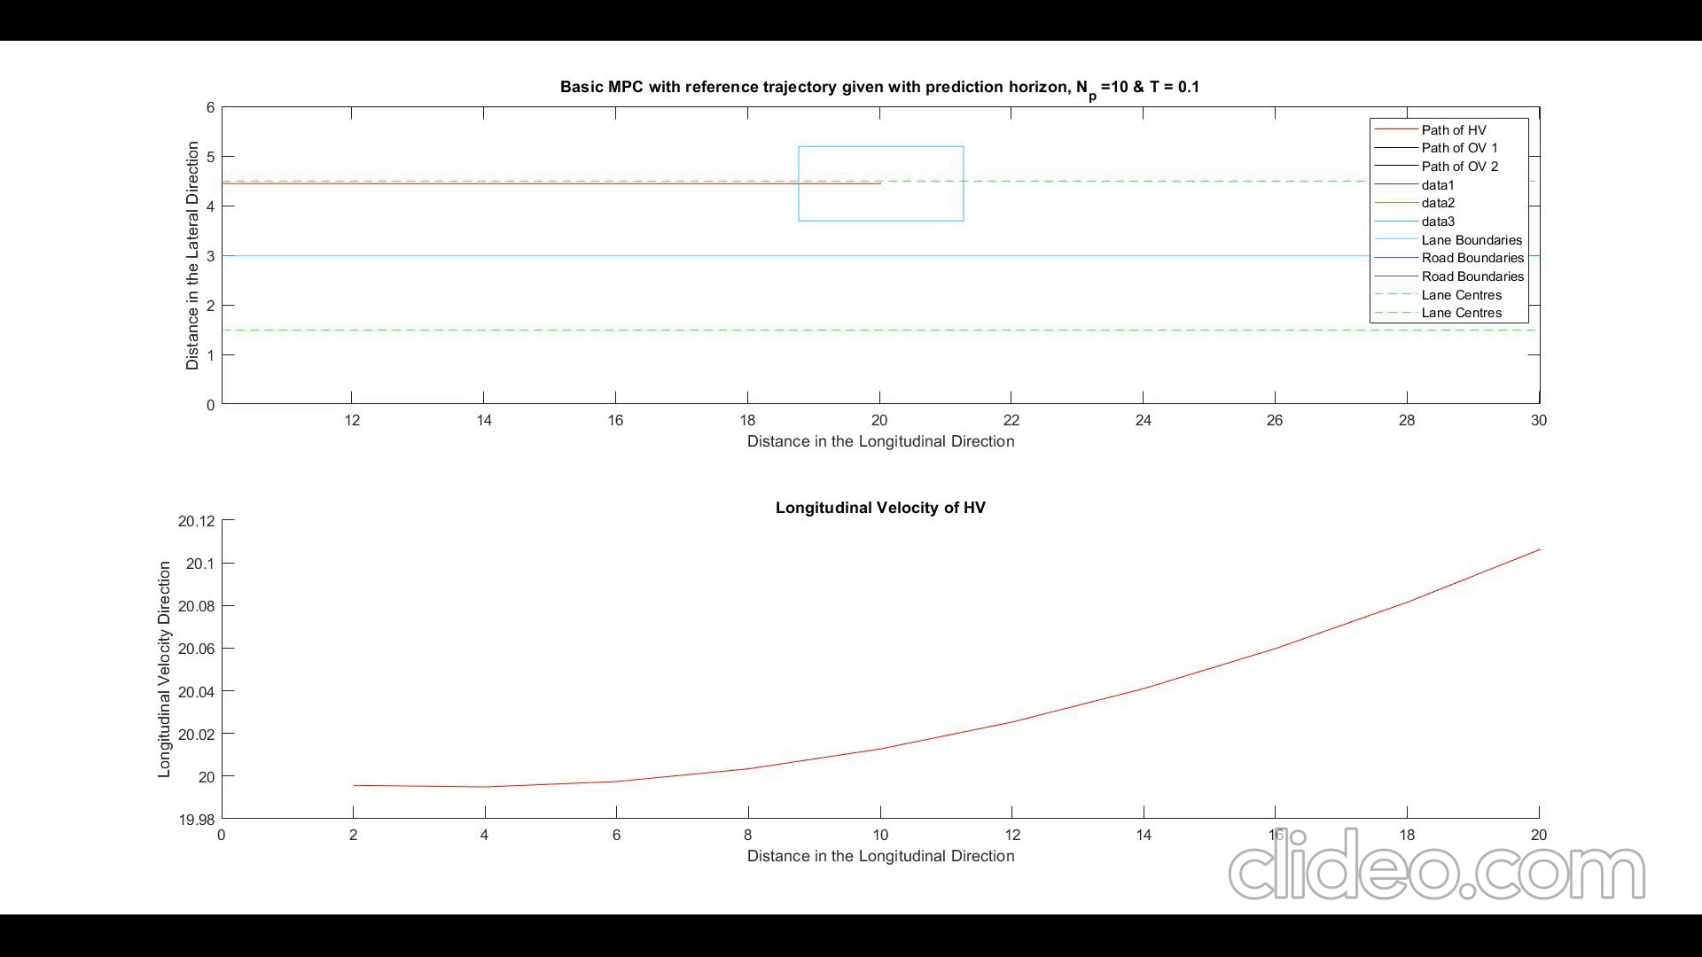
Path Travelled and Longitudinal Velocity of the Host Vehicle.

Slide 4
Working on
Literature Survey.
Writing down the theory
Design of Kalman Filter

